Slide 1
System Software
Chapter 7

Slide 2
System Software
consist of programs that control the operations of the computer and its devices
Serves as the interface between the user , your application software and your computers hardware.
Operating system and utility program

Slide 3
Uses of System Software
Starting up the computer
Opening, executing and running applications
Storing and retrieving and copying files
Formatting disk
Reducing file sizes
Backing up the contents of hard disk

Slide 4
Operating System
is a set of programs containing instructions that coordinate all of the activities among computer hardware resources.
it also contains instructions that allow you to run application software

Slide 5
THREE MAJOR FUNCTION
It coordinates and manipulates computer hardware.
it organizes files on a variety of storage media, such as floppy disk, hard drive, compact disc, and tapes
and it manages hardware errors and the loss of data.

Slide 6
Kernel – core of an OS
managing memory, files, and devices;
maintaining the computer’s clock, which contains the current date and time;
starting applications; and assigning the computer’s resources
software programs, data, and information. Each time you turn

Slide 7
User Interface
part of the software with which you interact.
controls how data and instructions are entered and information is presented on the screen.
command-line and graphical.

Slide 8
Types of User Interface
command-line interface
you type keywords or press special keys on the keyboard to enter data and instructions.
graphical user interface
allows you to use menus and visual images such as icons, buttons, and other graphical objects to issue commands.

Slide 9
Features of Operating system
Depending on its intended use, an operating system will support just running on program or thousands of users running multiple programs.
single user
Multi tasking
Multi user
Multi processing

Slide 10
Single user
also called single tasking operating system allows only one user to run program at a time

Slide 11
Multi tasking
operating system allows a single user to work on two or more applications that reside in the memory

Slide 12
time-slice multitasking
- whereby each process is run individually for a fixed period of time.
If the process is not completed within the allotted time, it is suspended and another process is run.
This exchanging of processes is called context switching.
The OS performs the “bookkeeping” that preserves the state of a suspended process.
It also has a mechanism, called a scheduler, that determines which process will be run next.

Slide 13
Multi user
operating systems enables two or more users to run a program simultaneously
allows hundreds of thousands of users to be connected at the same time.

Slide 14
Multi processing
operating system can support two or more CPU running programs at the same time
works much like parallel processing

Slide 15
Functions of an operating system
performs a number of basic functions that enable you and application software to interact w/ the computer.
Memory management
Spooling print jobs
configuring devices
Monitoring system performance
Administering security
managing storage media and files

Slide 16
Memory management
is to optimize use of RAM
has the responsibility to allocate or assign these items to an area of memory while they are being processed
to monitor carefully the contents of these items in the memory
To clear these items from memory when they are no longer required by the CPU.

Slide 17
buffer
is an area of memory or storage in which data and information is placed while waiting to be transferred to or form an input or output device.

Slide 18
Virtual memory
some operating systems use VM to optimize RAM
allocates a portion of a storage medium to function as additional RAM. This area of the hard disk used for VM is called a swap file because it use to exchange data, instructions between memory and storage
Technique of swapping items between memory and storage often called paging

Slide 19
thrashing
when operating system spends much of its time paging, instead of executing application software, it said to be thrashing.

Slide 20
Spooling Print Jobs
when you instruct an application to print a document, the document you are printing is called print job.
the print jobs are placed in a buffer instead of being sent immediately to the printer.
the program that manages and intercepts print jobs and places them in he queue is called the print spooler

Slide 21
Configuring devices
Device driver is a small program that accepts commands from another program and converts these commands in commands that the device understand.

Slide 22
Plug and Play
is the computer’s capability of recognizing any new device and assisting in the installation of the device by loading the necessary drivers automatically and checking for conflicts with other devices.
Interrupt Request (IRQ) is a communication line between a device and the CPU.

Slide 23
Monitoring System Performance
which is a program that assesses and reports information about various system resources and devices.

Slide 24
Administering Security
Most multi-user operating system allow each user to log on which is the process of entering username and password into the computer
It is a unique combination characters that identifies the user.

Slide 25
Managing Storage Medium and file
file manager performs function related to storage and file management
formatting and copying disks
displaying a list of files on a storage medium
checking the amount of used and free space on a storage medium
renaming, deleting, moving and sorting files

Slide 26
software that is privately owned and limited to vendor or computer model is called proprietary software
device independent operating system runs on many manufacturer’s computers
Downward-compatible operating system is one that recognizes and works with application software that was written in earlier version of the OS
Upward compatible was written for an earlier of the operating system but runs under the new version

Slide 27

Disk Operating System (DOS)
single user operating systems that was developed in early 1980
PC-DOS, MS-DOS
command-line interface
menu driven

Slide 28
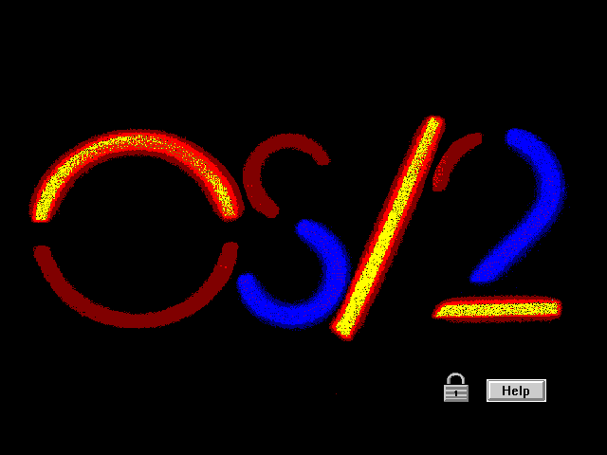
OS/2
Operating System 2, operating system developed for the personal computer in the mid-1980s by International Business Machines Corporation (IBM) and Microsoft Corporation.

Slide 29
Windows 3.X
Windows 3.0, Windows 3.1, Windows 3.11
operating environment is a graphical user interface that works with the combination with an operating system to simplify its use.
operating environment for DOS

Slide 30
Windows 95
improved graphical user interface which made working with files and programs easier than the earlier version.
take advantage of 32-bit processor
multi-tasking
Plug and Play Technology
longer file names and email

Slide 31
Windows NT
an operating system designed for client-server networks.
Server used Windows NT Server
Clients connected to server used Windows NT Workstation.

Slide 32
Windows 98
upgrade to Win 95
provide faster system startup and shutdown
better file management
file manager called Windows Explorer
Active Desktop allowed you to setup windows icon on the desktop and file names
support new multimedia technology
could run 16-bit to 32-bit software

Slide 33
Windows 2000
upgrade to Win98 and NT
is a complete multi-tasking operating system that has a graphical user interface
Windows 2000 Server Family
includes W2K Server, W2K Advanced Server and W2K Datacenter Server for various level of server
Windows 2000 Pro for stand-alone business desktop and laptop as well as for computers connected to the network called clients

Slide 34
Windows CE
is a scaled-down windows operating system designed for use on wireless communication devices and smaller computers
designed for smaller computing devices.
Auto PC is directed through voice commands.

Slide 35

UNIX
developed in early 1970’s by Bell Laboratories.
capable of handling a high volume of transaction in a multi-user environment and working with multiple CPU’s using multiprocessing
Used often on workstation & servers
commands are difficult to remember
lack some of system administration

Slide 36
Linux
is not proprietary software
open- source software which means its code is made available to public
customers can personalized the software to meet their needs
users that modify the software share their improvements w/others .
Red Hat Software Corel Corporation

Slide 37
NetWare
is a widely used network operating system designed for client-server networks
allows you to share hardware devices attached to the server and files or application stored on the server.

Slide 38
Utility Program
is a type of system software that performs specific task usually related to managing a computer, its devices, or its programs.
system tools menu
stand-alone utilities

Slide 39
Function
viewing files
compressing files
diagnosing problems
scanning hard disk
defragmenting disk
installing software
backing up files and disk
checking for viruses
and displaying screen saver

Slide 40
File viewer
is a utility that displays the contents of a file.. File viewer..
Quick view to display the contents of text files
Imaging preview for graphics

Slide 41
File compression
reduces or compresses the size of a file.
a compressed file take up less storage space on a storage medium which frees up room on the disk and improves system performances.
compressed file is called zipped files
PKZIP, WINZIP

Slide 42
Diagnostic Utility
performs technical information about your computer hardware and certain system software programs and then prepares a report outlining any identified problems

Slide 43
Disk scanner
detects and corrects both physical and logical problems on a storage medium.
Searches and removes unwanted files
Physical problems is one in the media. Logical problem is the one in the data
Scandisk which detects and corrects problems
Disk cleanup which searches for and removes unnecessary files ex. Temp file

Slide 44
Disk defragmenter
utility that reorganizes the files and unused space on a hard disk so data can accessed more quickly. And programs can run faster.
contiguous, non contiguous

Slide 45
Uninstaller
is a utility that removes an application, as well as any associated entries in the system files.

Slide 46
Backup utility
allows you to copy or backup, selected files or your entire hard disk onto another disk
during the backup process the backup utilities monitors progress and alerts you if additional disk is needed
many backup programs will compress files during this process

Slide 47
Antivirus
is a utility that prevents, detects and removes viruses from a computer’s memory or storage devices
Virus is a program that copies itself into other programs and spreads through multi-pie computers.
viruses often are designed to damage a computer intentionally by destroying or corrupting its data.

Slide 48
Screen saver
that causes the monitor’s screen to display a moving image or blank screen if no keyboard or mouse activity occurs for a specified time period

